Slide 1
Model Optimization
W4D4 – LHL Bootcamp July
Arunabh Singh

Slide 2
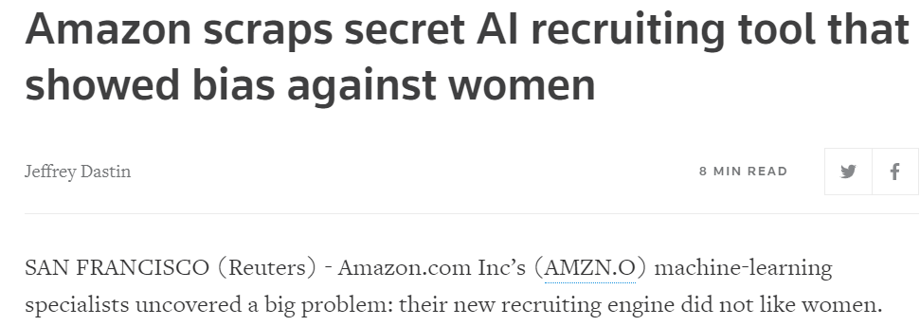
Case Study in Amazon
News from 2 years ago. Amazon faced a lot of negative publicity for its’ biased AI Engine.

Slide 3
Reasons for Bias
That is because Amazon’s computer models were trained to observe patterns in resumes submitted to the company over a 10-year period. Obviously there was male dominance across the tech industry.
The system downgraded candidates who had words like ‘Women’s chess club captain’ or any other such instance of words with ‘woman’ in it.
How did this happen?
Amazon recognized around 50000 terms. It placed low importance on IT skills such as ‘writing computer code’. It instead placed high value on verbs like ‘executed’ and ‘captured’.
These verbs are how men write their resumes and thus it was looking for ‘Masculine Language’ within resumes.
Algorithmic Fairness is still an issue.

Slide 4
What is Bias from a technical perspective?
Bias is learning too much from your training dataset.
The biased model thus tries to always look for exactly similar data to classify correctly.
A biased model does not scale/generalize well to real world data.
A model with low Bias has High-Variance.
A model with low Variance has High Bias.
This is known as the Bias-Variance Trade-Off

Slide 5
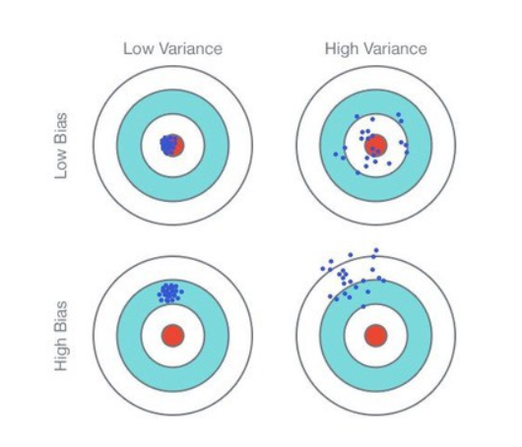
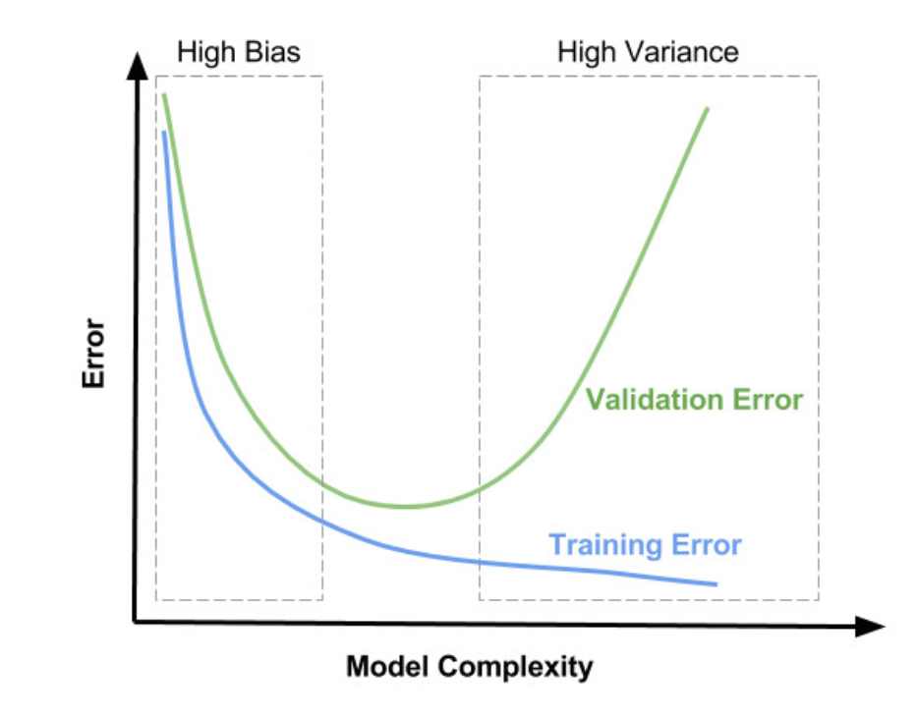
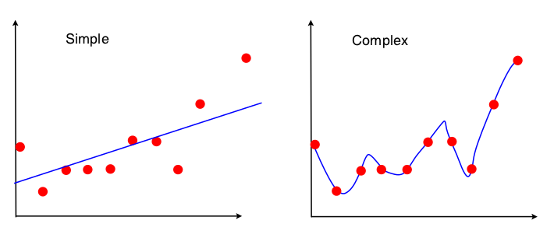
Bias Variance Trade-Off
Bias is the simplifying assumptions made by the model to make the target function easier to approximate.
Variance is the amount that the estimate of the target function will change given different training data.
Trade-off is tension between the error introduced by the bias and the variance.
If our model is too simple and has very few parameters then it may have high bias and low variance.
On the other hand, if our model has a large number of parameters then it’s going to have high variance and low bias.
So we need to find the right/good balance without overfitting and underfitting the data.

Slide 6
OLS revisited interactive example
https://setosa.io/ev/ordinary-least-squares-regression/

Slide 7
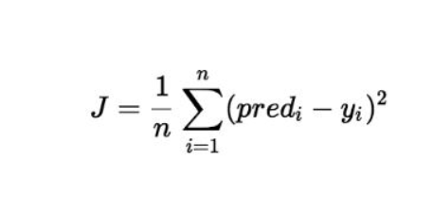
Gradient Descent vs OLS
Gradient Descent takes less computations compared to OLS(Ordinary Least Squares). Gradient Descent find solution using iterations.
OLS does not work for regularization(Lasso).
Gradient Descent uses cost function
Gradient Descent goes through entire dataset to try and reduce this Cost Function to its minimum value.
Once cost function stops minimizing further, we know we have the best predicted values by using our data for training.

Slide 8
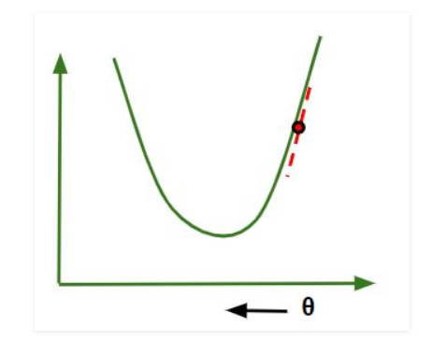
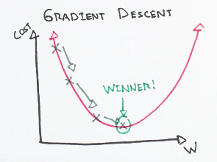
Why minimize the Cost Function ?
The minima of Cost Function is the best fit of line/curve for all the points in the dataset.
Initial Stage Final Stage
We find Optimal Weights for getting to the minimum point of Cost Function.
In doing so, we fit the best line for our points.
W

Slide 9
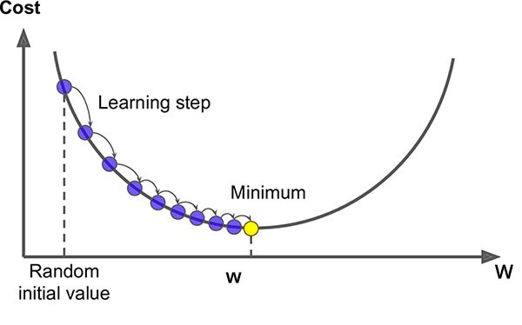
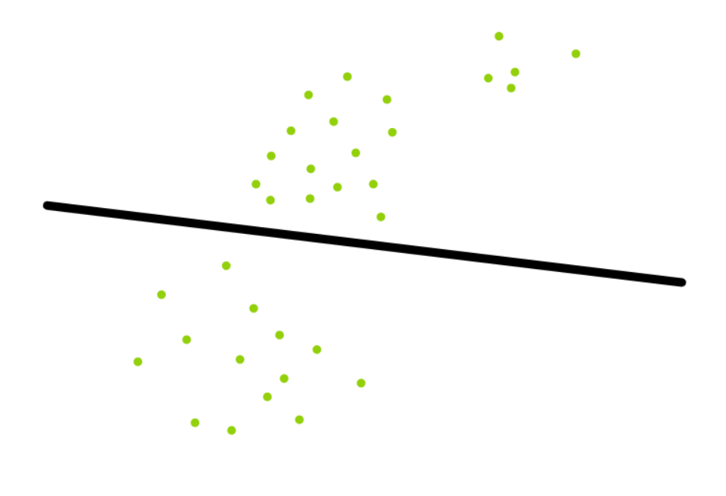
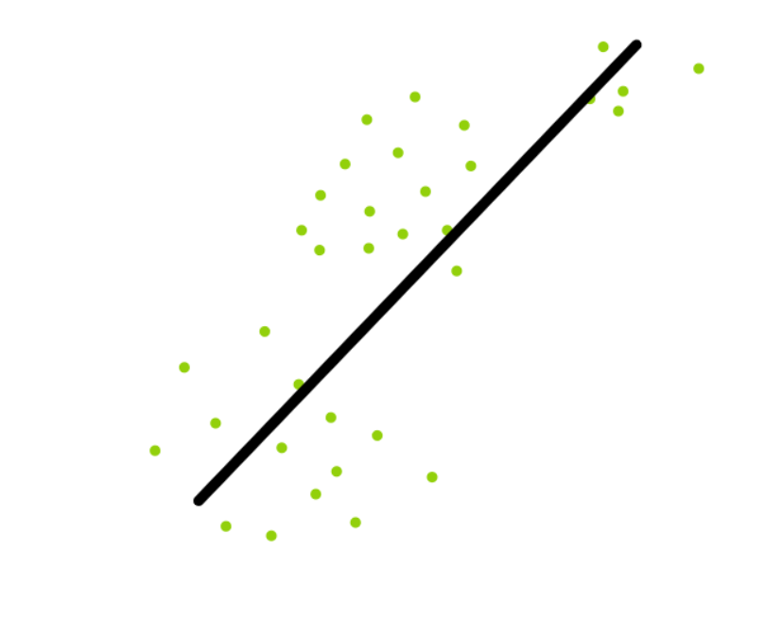
Initial Prediction Function vs Final versus Final Curve after GD
Initial H(x) with random weights
Our H(x) with updated weights after Gradient Descent

Slide 10
Stochastic Gradient Descent
Gradient Descent has different versions based on when the Weights for our prediction function H(x) are updated.
Since cost function is of the form 1/n*(sum[pred(i)^2 – y[i]^2)), it is very expensive computationally.
Pred(i) = (W1*X1 + W2*X2 +..+Wn*Xn)
F(W1,…,Wn)
Gradient Descent is slow on large data(many rows and many columns).
SGD randomly picks one point in each iteration and for this one point, cost function is calculated and weights are updated.
This process of random point selection keeps going on. And each iteration the weights get updated for H(x).
This process is stochastic gradient descent.

Slide 11
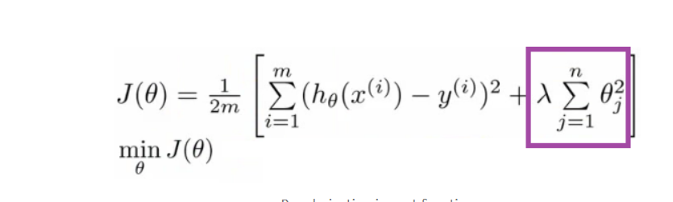
Regularization
Overfitting is when Model learns signal plus noise in training data.
This means it does not generalize well and will not do well on data other than the training data. Basically, the model is pretty useless.
This is solved using regularization techniques. Regularization adds penalty terms if our H(x) gets more complex.
These penalty terms reduce complexity and reduce overfitting.
Overfitting is when Model learns signal plus noise in training data.
As seen in the formula, lambda term penalizes all Weights(represented using Wi or Theta)
Penalty ensures these Weights have to be minimized more by Gradient Descent to achieve the Global Minimum.

Slide 12
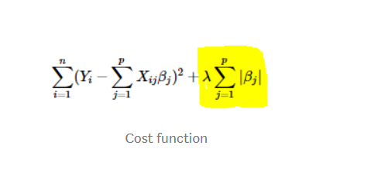
L1 regularization or Lasso
L1 regularization uses absolute(modulo) of Weights in H(x) and adds them to cost function.
If lambda is small Weights get penalized less and we have correct fitting curve.
If lambda is too large, weights get over penalized and we have under-fitting curve
If lambda is too large, weights get over penalized and coefficients will turn zero
Since Lasso Regression turns less important coefficients or weights in H(x) to zero, it acts like a feature selection technique.

Slide 13
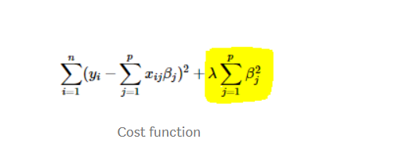
L2 regularization or Ridge
L2 regularization uses square of Weights in H(x) and adds them to cost function.
If lambda is small Weights get penalized less and we have correct fitting curve.

